Slide 1
Looking Past the Box Score
Andrew M, Ethan S, Zach F

Slide 2


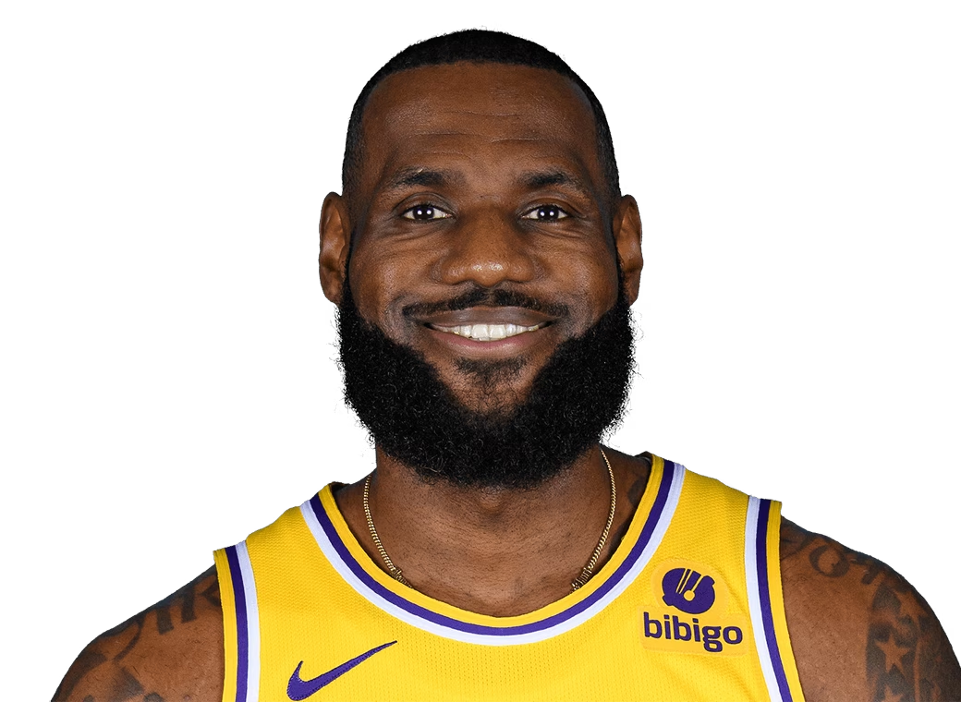
Introduction
Research Question: Research if VORP increases by season and investigate to see if the rate at which VORP changes by season varies from player to player in the NBA.

Slide 3
Agenda
1
2
3
4
Data Collection
Exploring Data
Modeling
Results

Slide 4
01
Data Collection

Slide 5
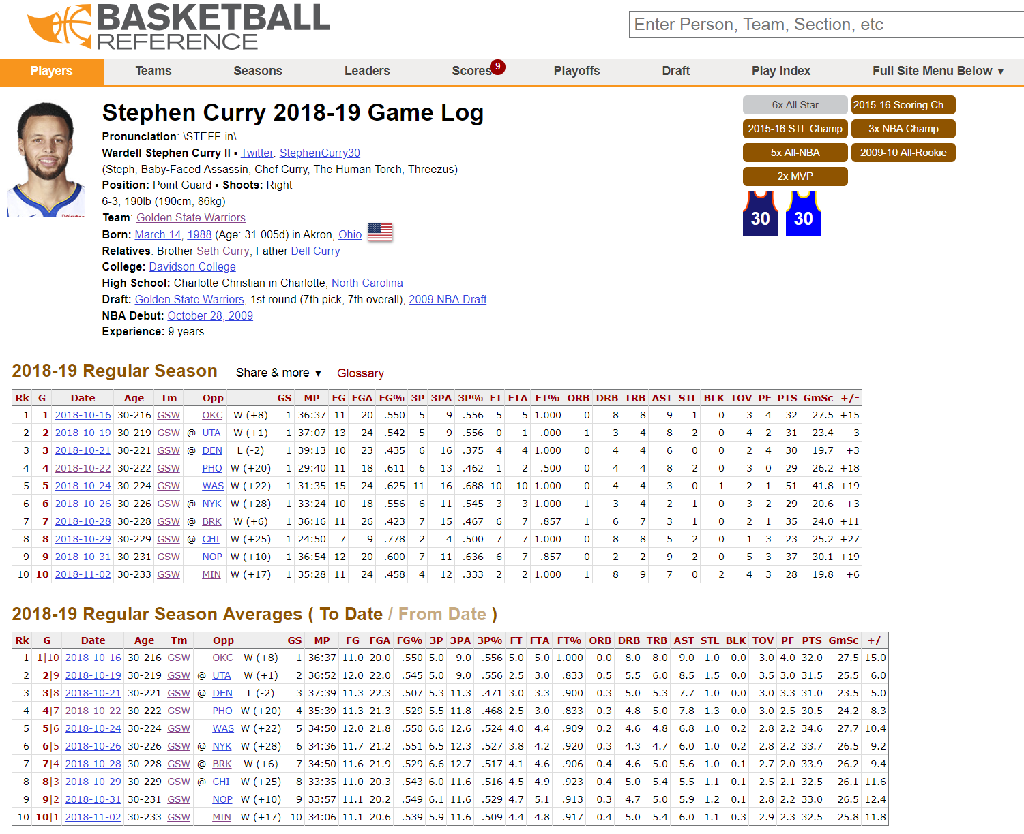

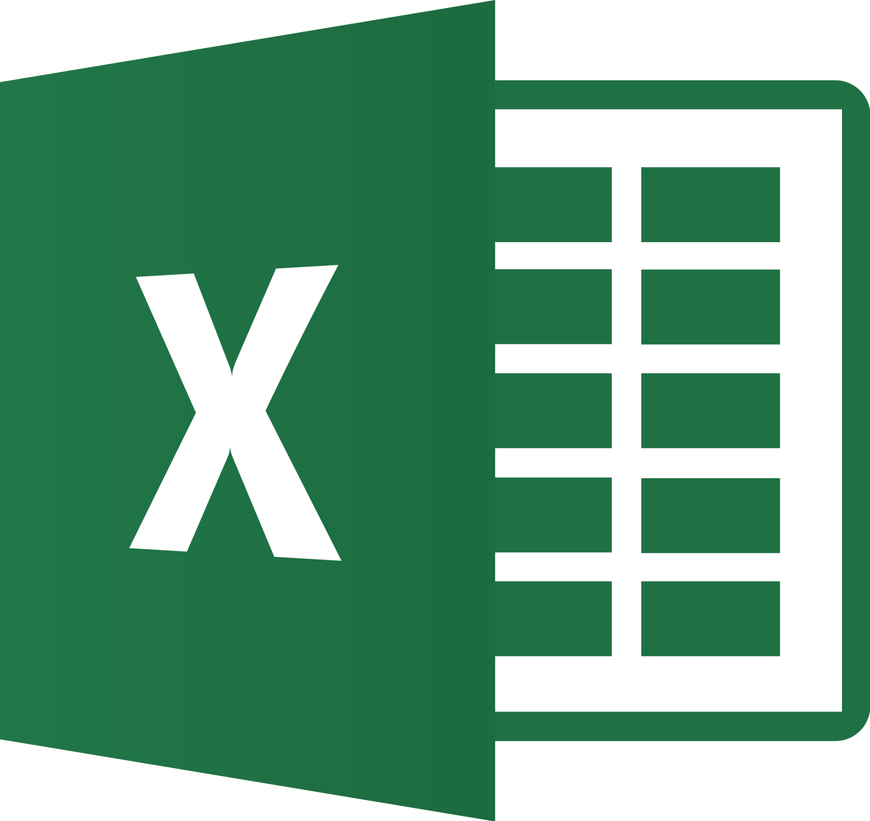
Data Collection

Slide 6
02
Exploring Data

Slide 7
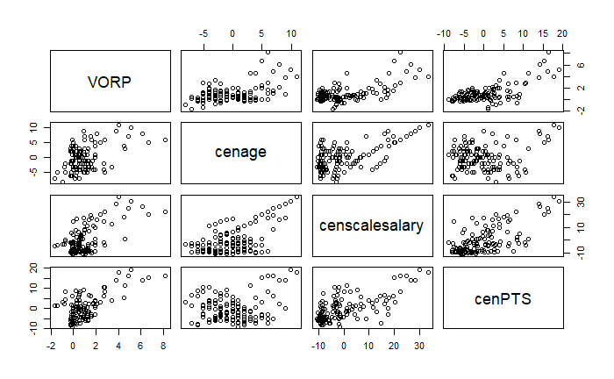
Data Exploration
Level 1
cenage: Centered age
censcalesalary: Average salary for that season in millions
cenPTS: Average PPG for that season GMC
Level 2
mean PTS: 2016-2023 Average PPG
bindraft: 1 if drafted in lottery 0 if not
Years In College: # of years player spent in college
Notes:
Matrix scatterplot, cenPTS is most interesting because of strongest visual correlation

Slide 8
Our Multilevel Data
Player
Season 2016-17
Season 2022-23
Season 2017-18
Season 2019-20
Season 2021-22
Season 2018-19
Season 2020-21
Notes:
Level 1 observation seasons, level 2 observations players career over 7 seasons

Slide 9
03
Modeling

Slide 10
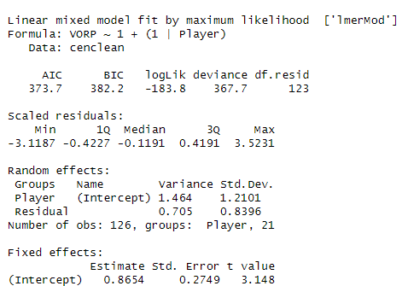
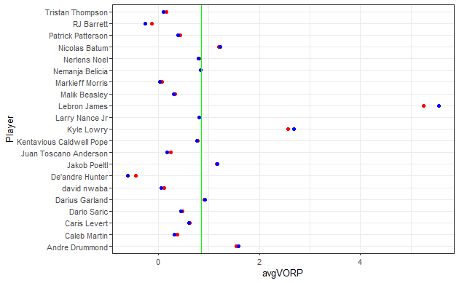
Null Model
Notes:
blue = OLS, red = MLM, effects aren’t constant across players and are clearly pulling the red dots towards the overall mean more

Slide 11
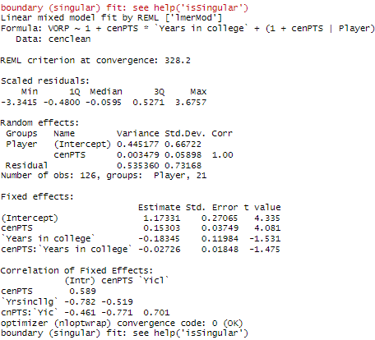
Final Model
Level 1:
VORP_{ij} = 𝛽_{0j} + 𝛽_{1j}cenPTS_{ij} + 𝜀_{ij}
Level 2:
𝛽_{0j} = 𝛽₀₀ + 𝛽₀₁yearsincollege_{j} + u_{0j}
𝛽_{1j} = 𝛽₁₀ + 𝛽₁₁yearsincollege_{j} + u_{1j}
Notes:
interaction and level2 not significant BUT makes for a more interesting model

Slide 12
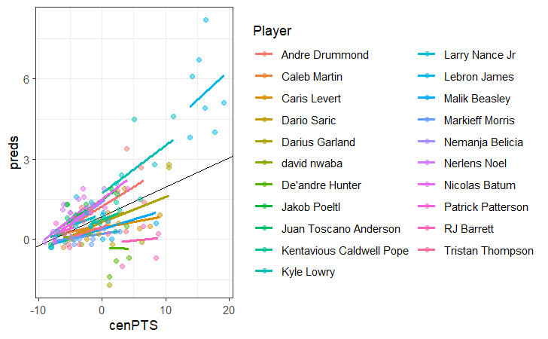
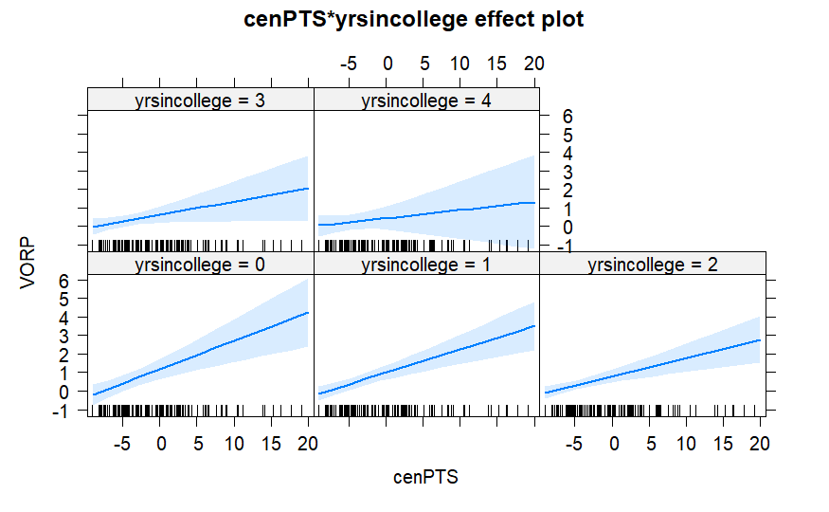
Final Model Visualizations
Notes:
although interaction is interesting, it is insignificant

Slide 13
04
Results

Slide 14
Results
Research Question: Research if VORP increases by season and investigate to see if the rate at which VORP changes by season varies from player to player in the NBA.
Predicted VORP did not significantly change by season (our time variable cenage was not sig)
However predicted VORP DID significantly change with cenPTS
Rate at which cenPTS affects VORP does vary significantly between players
Although not significant, years in college has an interesting interaction with cenPTS
Notes:
maybe briefly mention AR model stuff, adding more players to a bigger model

Slide 15
Thank You!

